Slide 1
EnviroSlides
By team GeoLearn
Samuel Prasse, Kaitlyn Grubb, Tyler Pehringer, Joshus Tenakhongva

Slide 2
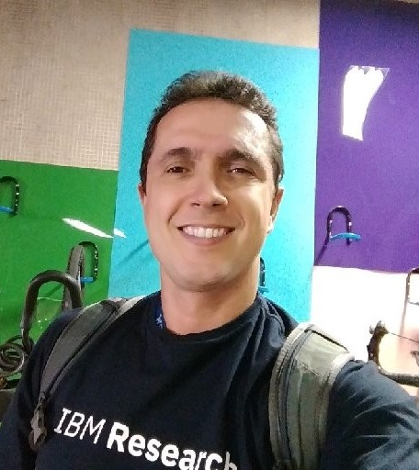
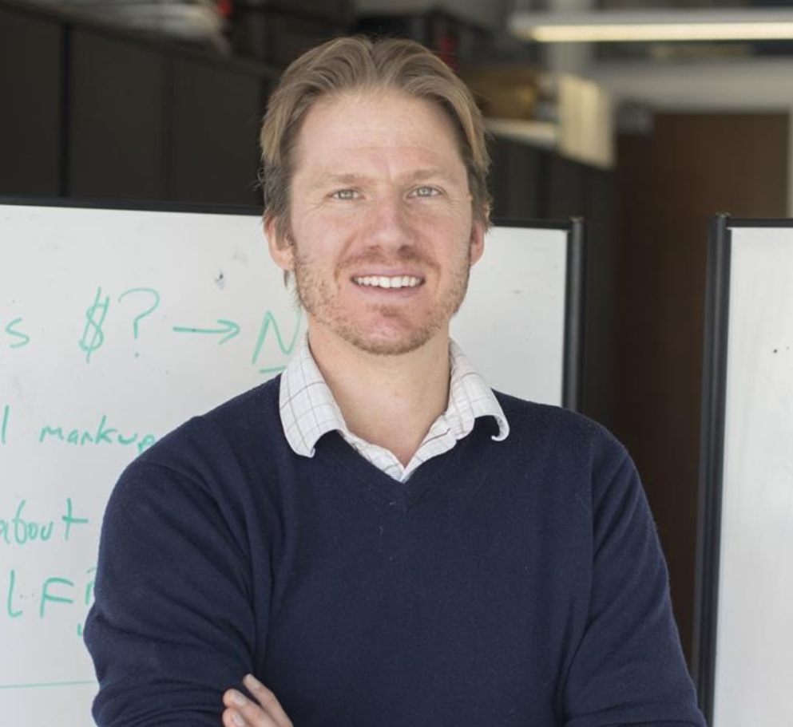
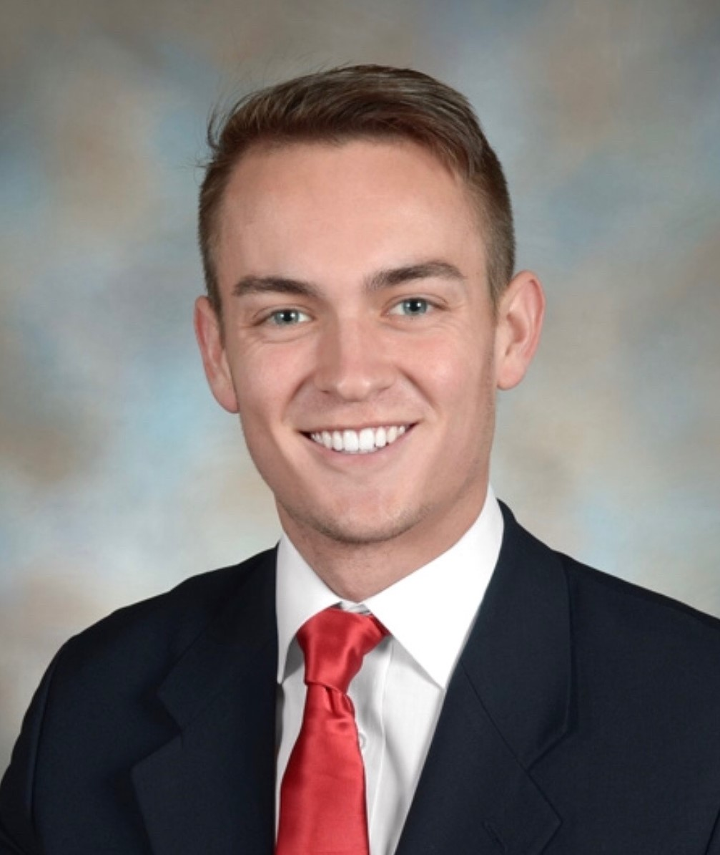
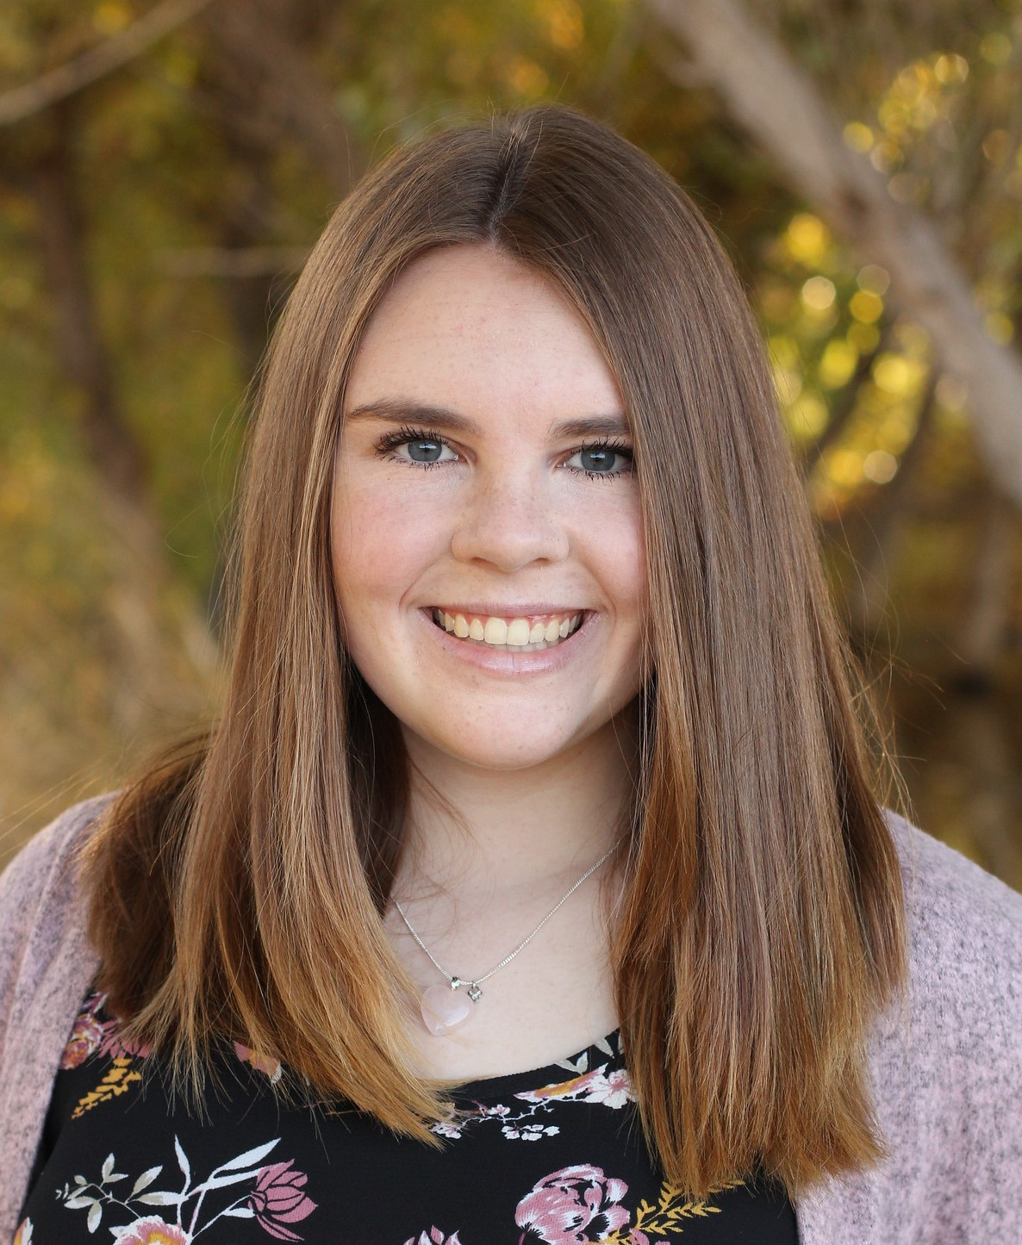
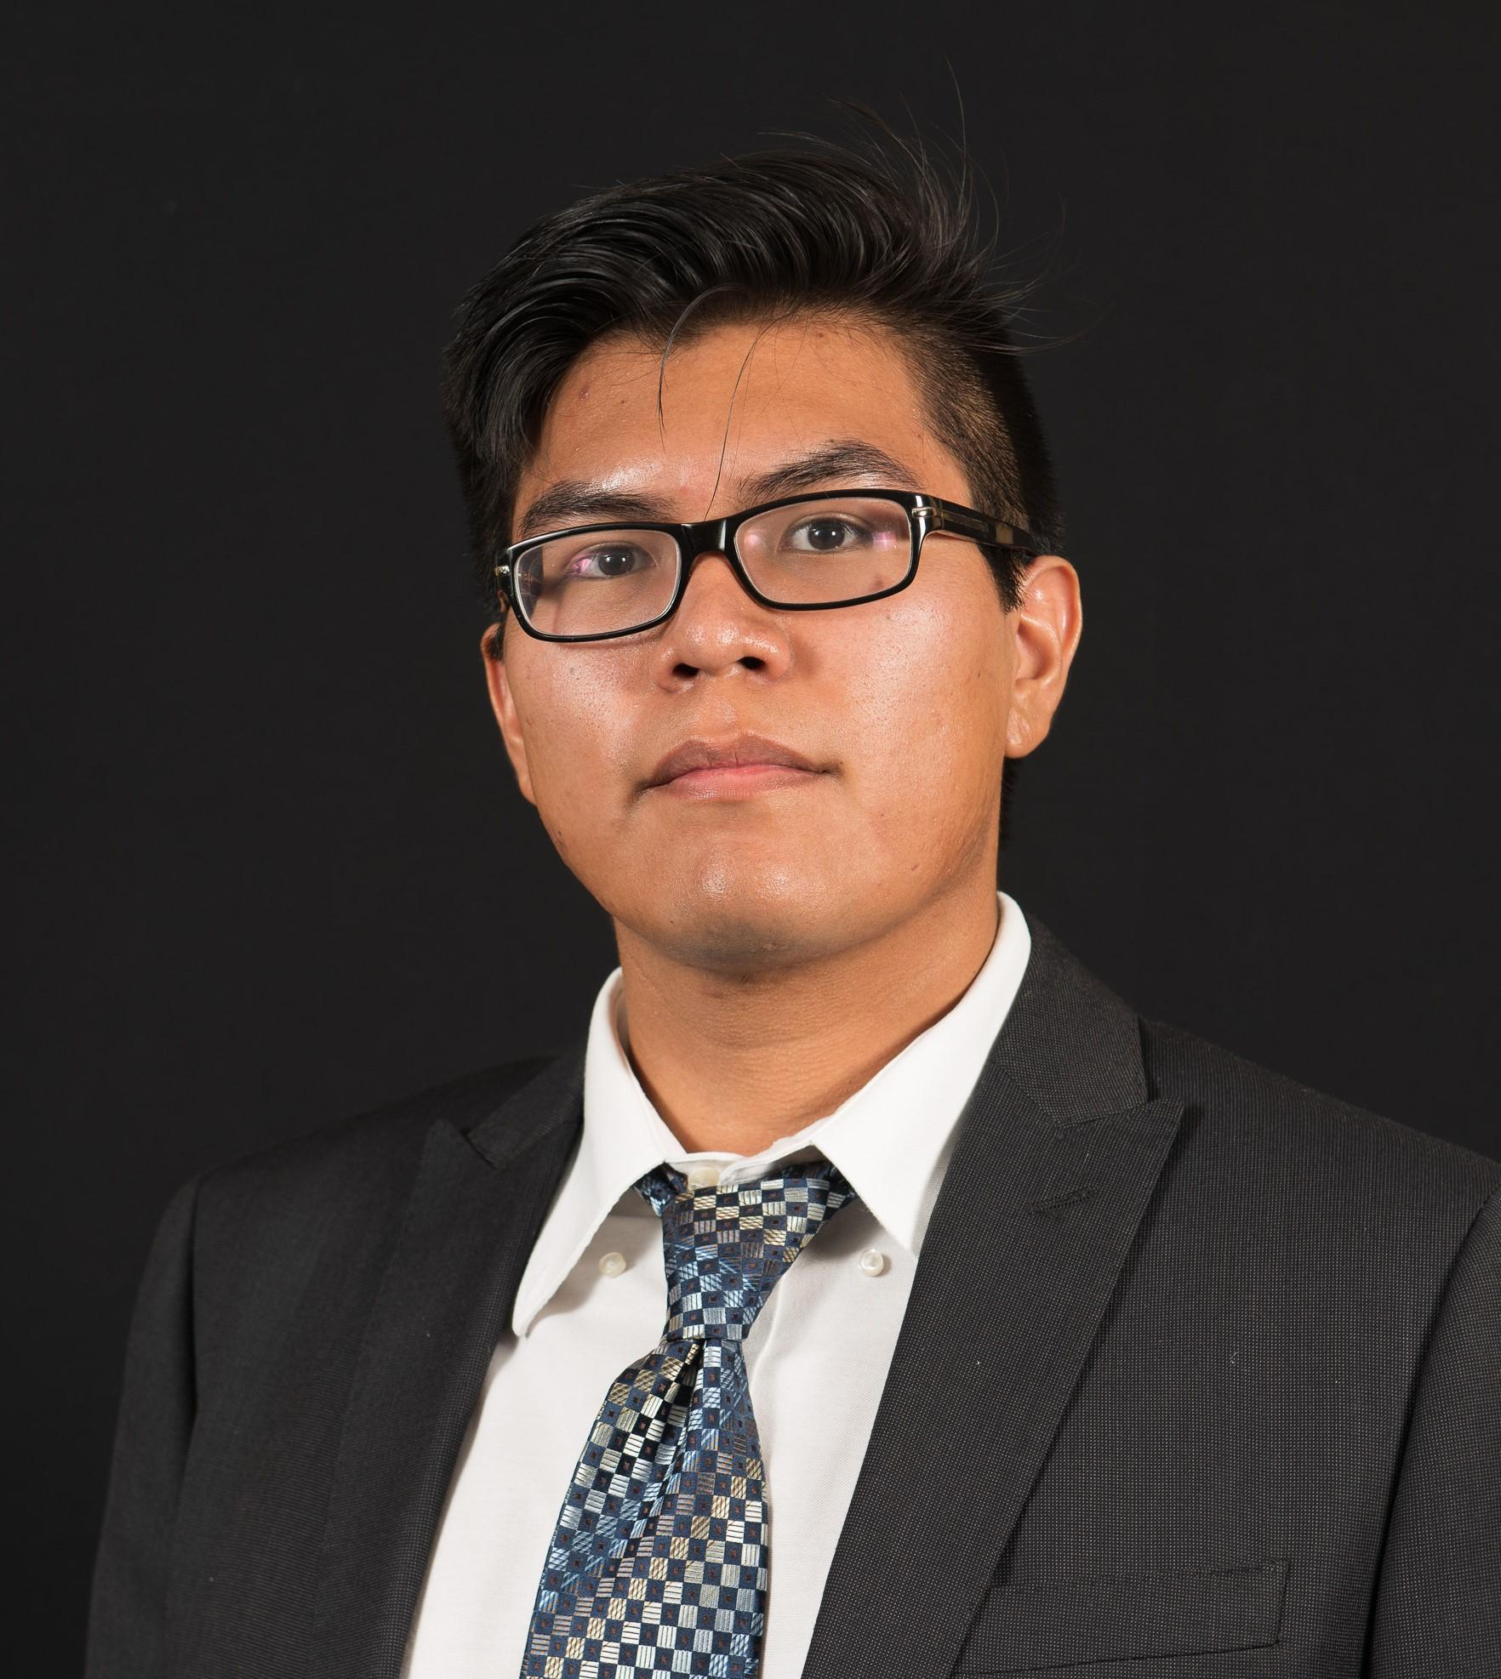
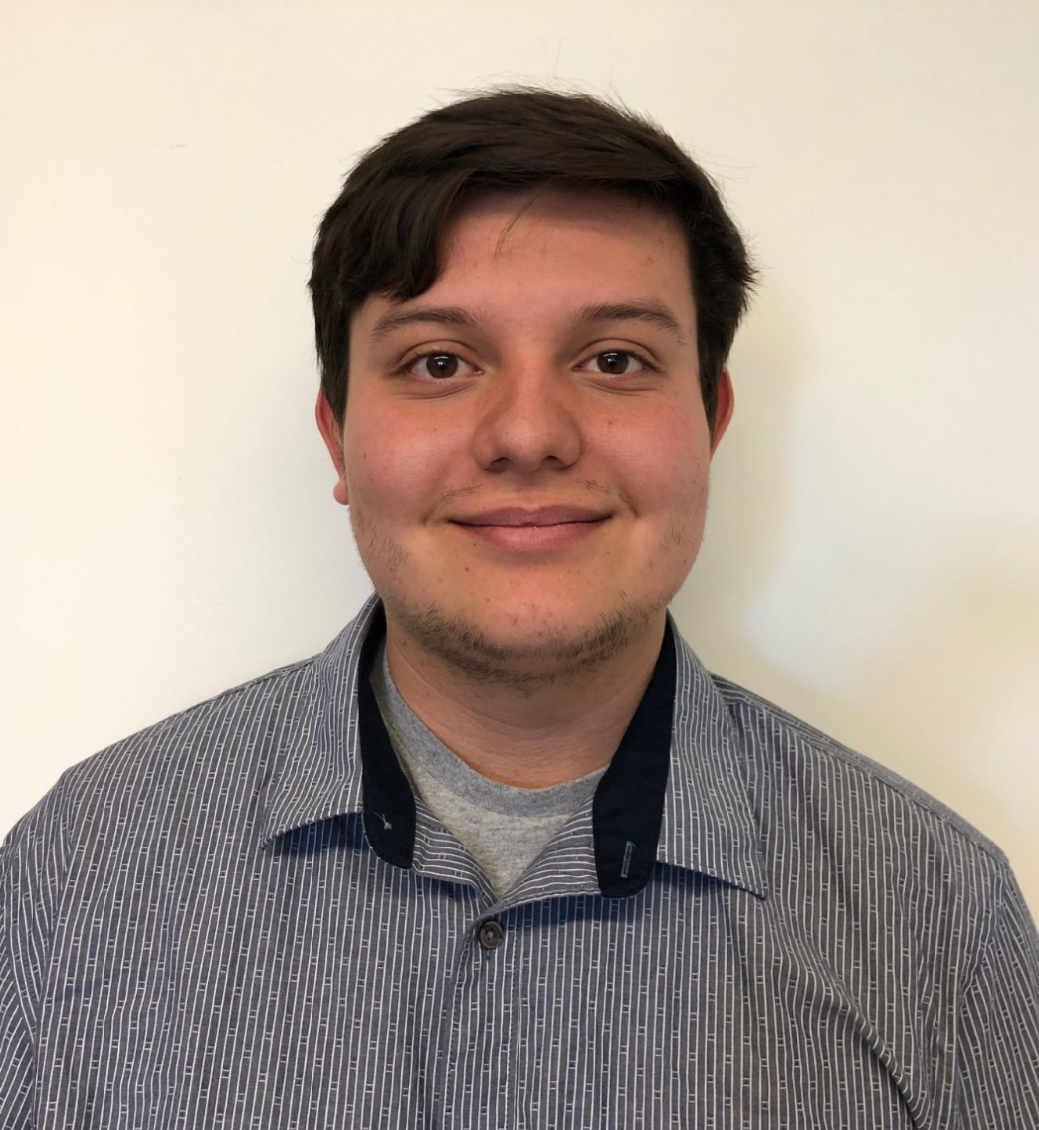
Introduction
Dr. Chris Doughty
Andrew “Roo” Abraham
Fabio Santos
Team Lead
Team Architect
Team Writer
Team Editor

Slide 3
Problem Statement
Regionally Specific
Accessibility

Slide 4
Problem Statement - Business Area
What do people need?
Building a link between science and education
Accessible science for those who are not specialists

Slide 5
Problem Statement - The Sector
1.9 Billion Children in the world
55% of Americans chose the Environment as a top priority
https://www.pewresearch.org/fact-tank/2017/04/20/for-earth-day-heres-how-americans-view-environmental-issues/
https://ourworldindata.org/primary-and-secondary-education

Slide 6
Problem Statement - The Sponsor
Dr. Doughty and Roo Abraham
Doughty Lab research aims to understand:
Animals
Ecosystems
Human impact

Slide 7
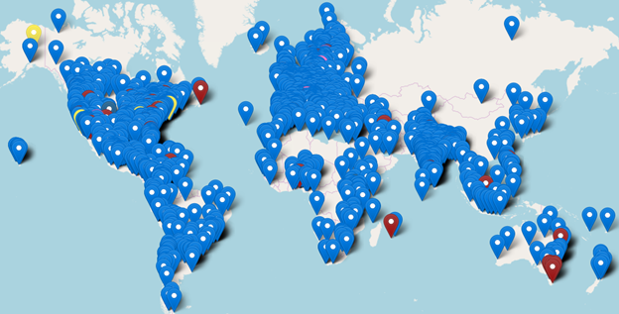
Problem Statement - Some Data
Google Earth Engine gives us access to Petabytes of data
Kids WANT this data
We have the tool to give it to them
https://www.fridaysforfuture.org/statistics/map

Slide 8
Problem Statement - A closer look

Slide 9
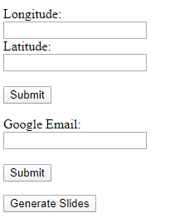
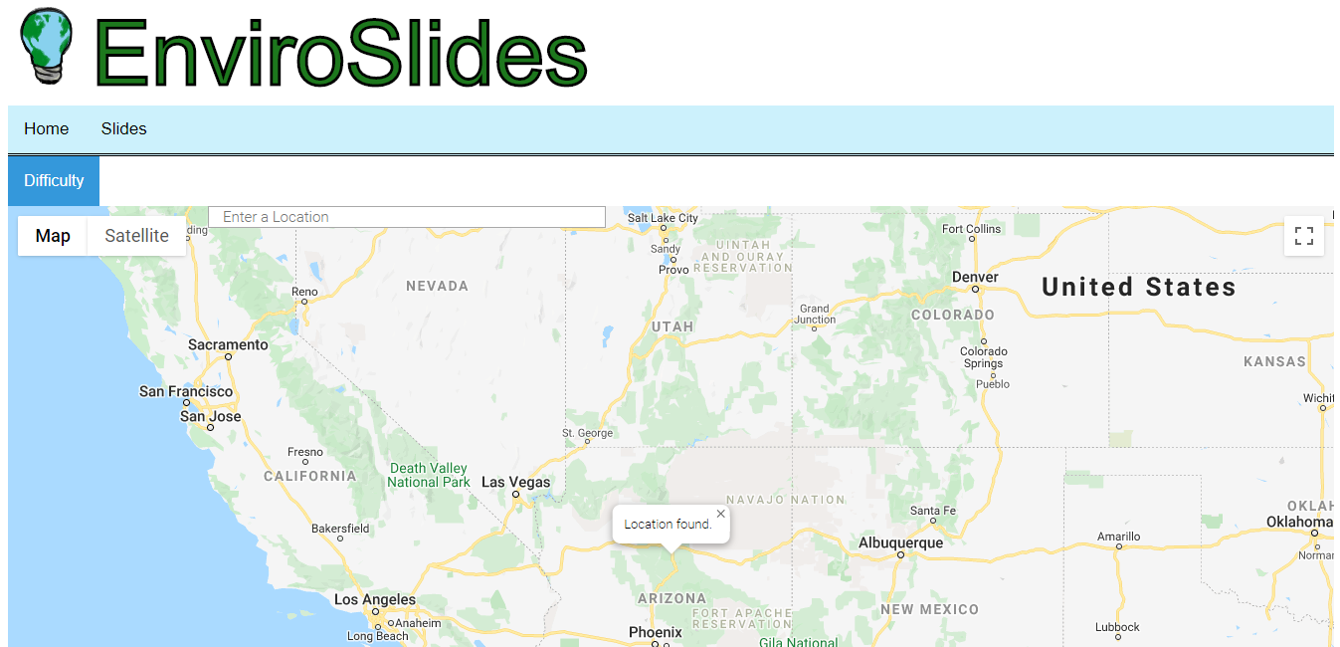
Solution Overview
A web application that generates presentations.
Presentations are based on environmental information.
Presentations will have information automatically placed onto the slides.

Slide 10
Key Requirements
Generate slides based on location
Develop interactive pages to accompany the slides
Slides must grab info automatically
Slides must save to users Google Drive
Slides must format info properly

Slide 11
Requirements - Generate a Slide Show Based on Location
Get info - location, subject, and difficulty
Get slide data based on location, subject, and difficulty
Put information into a slide
Deliver slide to user

Slide 12
Requirements: Performance
Slide Generation Time
Slides must be generated in a reasonable time period
User interface
Easy to navigate
Accessibility
Web app must be available from home

Slide 13
Implementation and Architecture

Slide 14
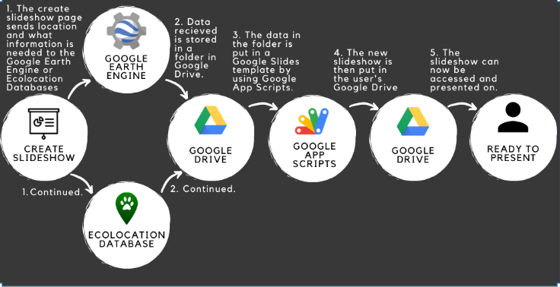
Implementation

Slide 15
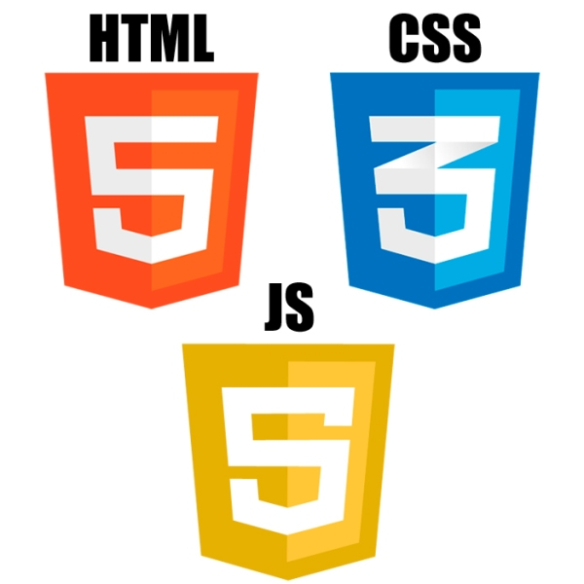
Our Form gathers information to generate slides.
School Name
Location
Presentation Type
Difficulty
Google Account
Primary Tool
Input: User input into a form
Output: The form inputs get sent as strings as inputs for what data to gather in the next steps

Slide 16
Data is collected from the two databases depending on the location/type/difficulty.
Primary Tool
Input: location
Output: Videos, charts, and data points uploaded to the Geolearn Google Drive
Primary Tool
Input: location
Output: Data and pictures uploaded to the Geolearn Google Drive

Slide 17
The Google Drive Stores
A folder including data gathered from the previous step
Presentation templates
Google App Scripts
Input: The Google App Scripts use the data stored in the folder. Also input is the type, difficulty, school name, and user email.
Primary Tool
Output: The finished presentation is transferred ownership to the Google Account provided from the form.

Slide 18
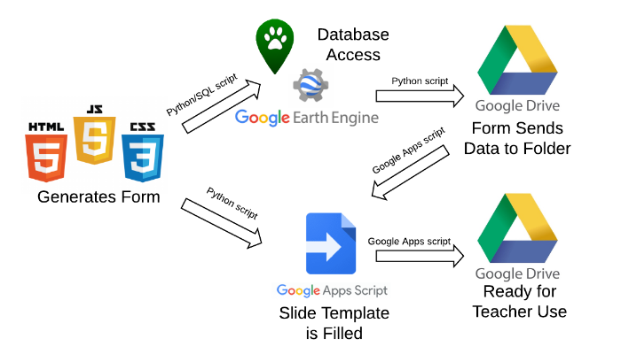
How do all These Tools Interact

Slide 19
Prototype Review
Landing Page

Slide 20
Prototype Review
Slides Page

Slide 21
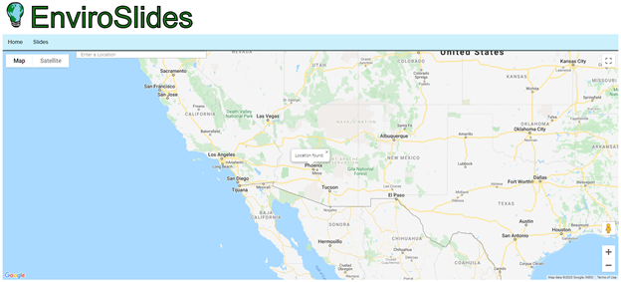
Prototype Review
Biodiversity Page

Slide 22
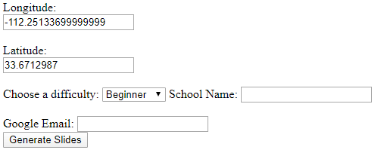
Prototype Review
Biodiversity Page continued

Slide 23
Prototype Review
User’s Gmail Account

Slide 24
Prototype Review
Biodiversity Basic Presentation

Slide 25
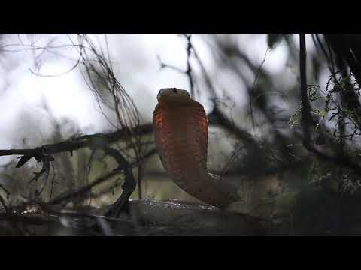
Prototype Review
Biodiversity Basic Presentation Content

Slide 26
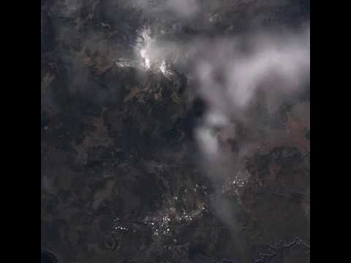
Prototype Review
Biodiversity Basic Presentation Content continued

Slide 27
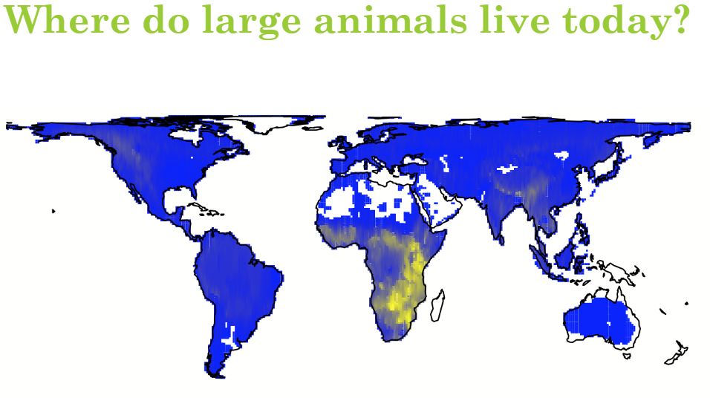
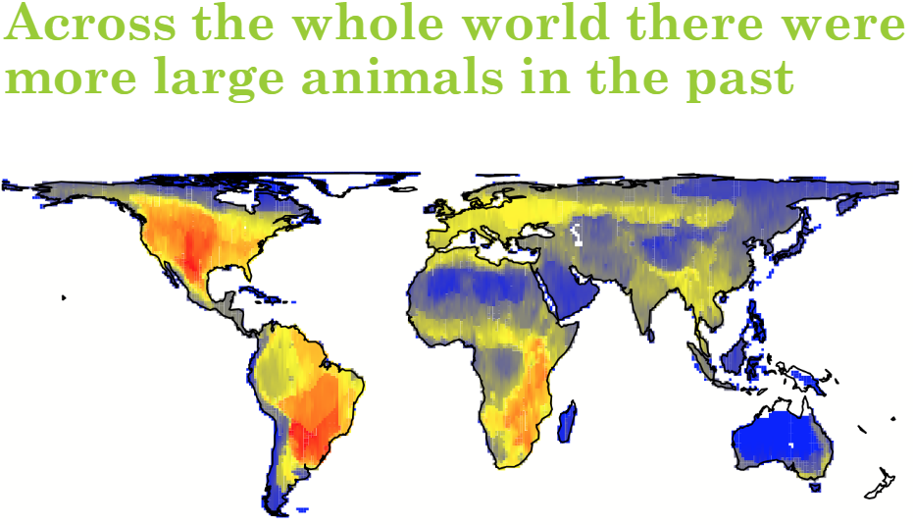
Prototype Review
Biodiversity Basic Presentation Content continued

Slide 28
Challenges and Resolutions
Slides and Database info do not match up.
Restructured scripts.
Trying to keep the main server up.
Updated django framework.
Image Handling issues.
New algorithm created.

Slide 29
Schedule

Slide 30
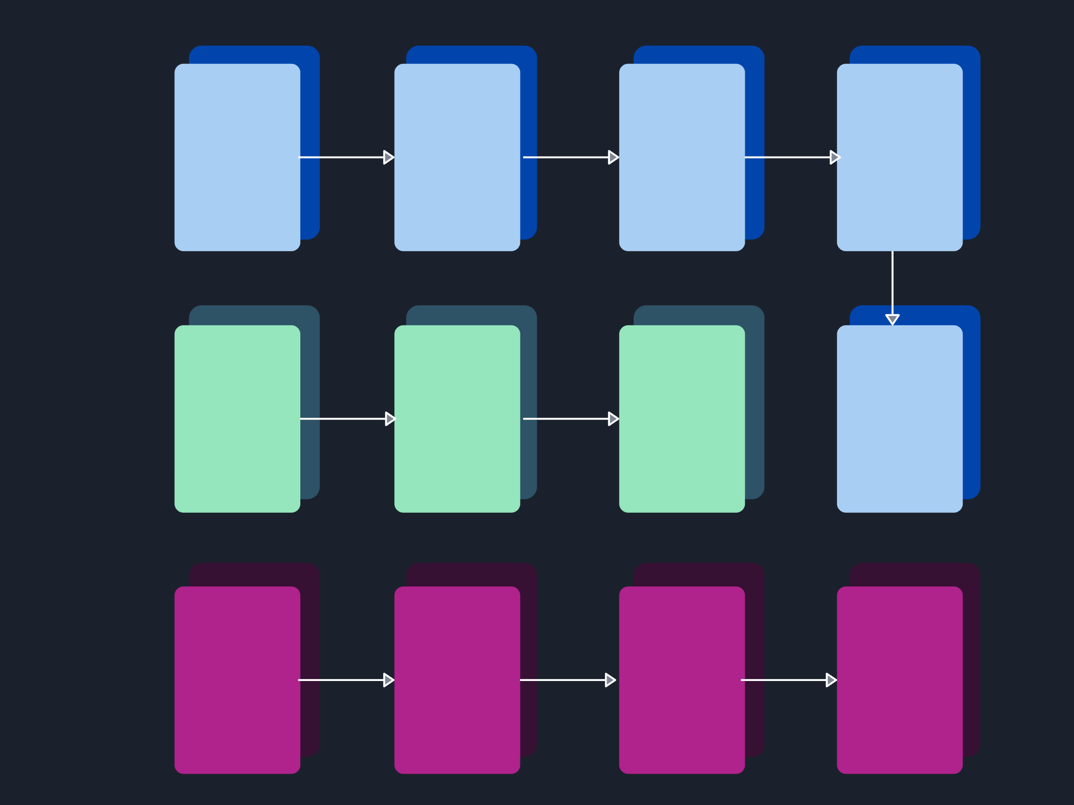
Testing Plan
Unit
Testing
Testing
Data
Scripts
Testing
Individual
Slides
Testing
Website
Front-
End
Scripts
Scripts
To
Slides
Testing
Server
Integration
Testing
Usability
Testing
Combined
Moderation
Tests
Remote
And
In-person
Tests
Assessment
Testing

Slide 31
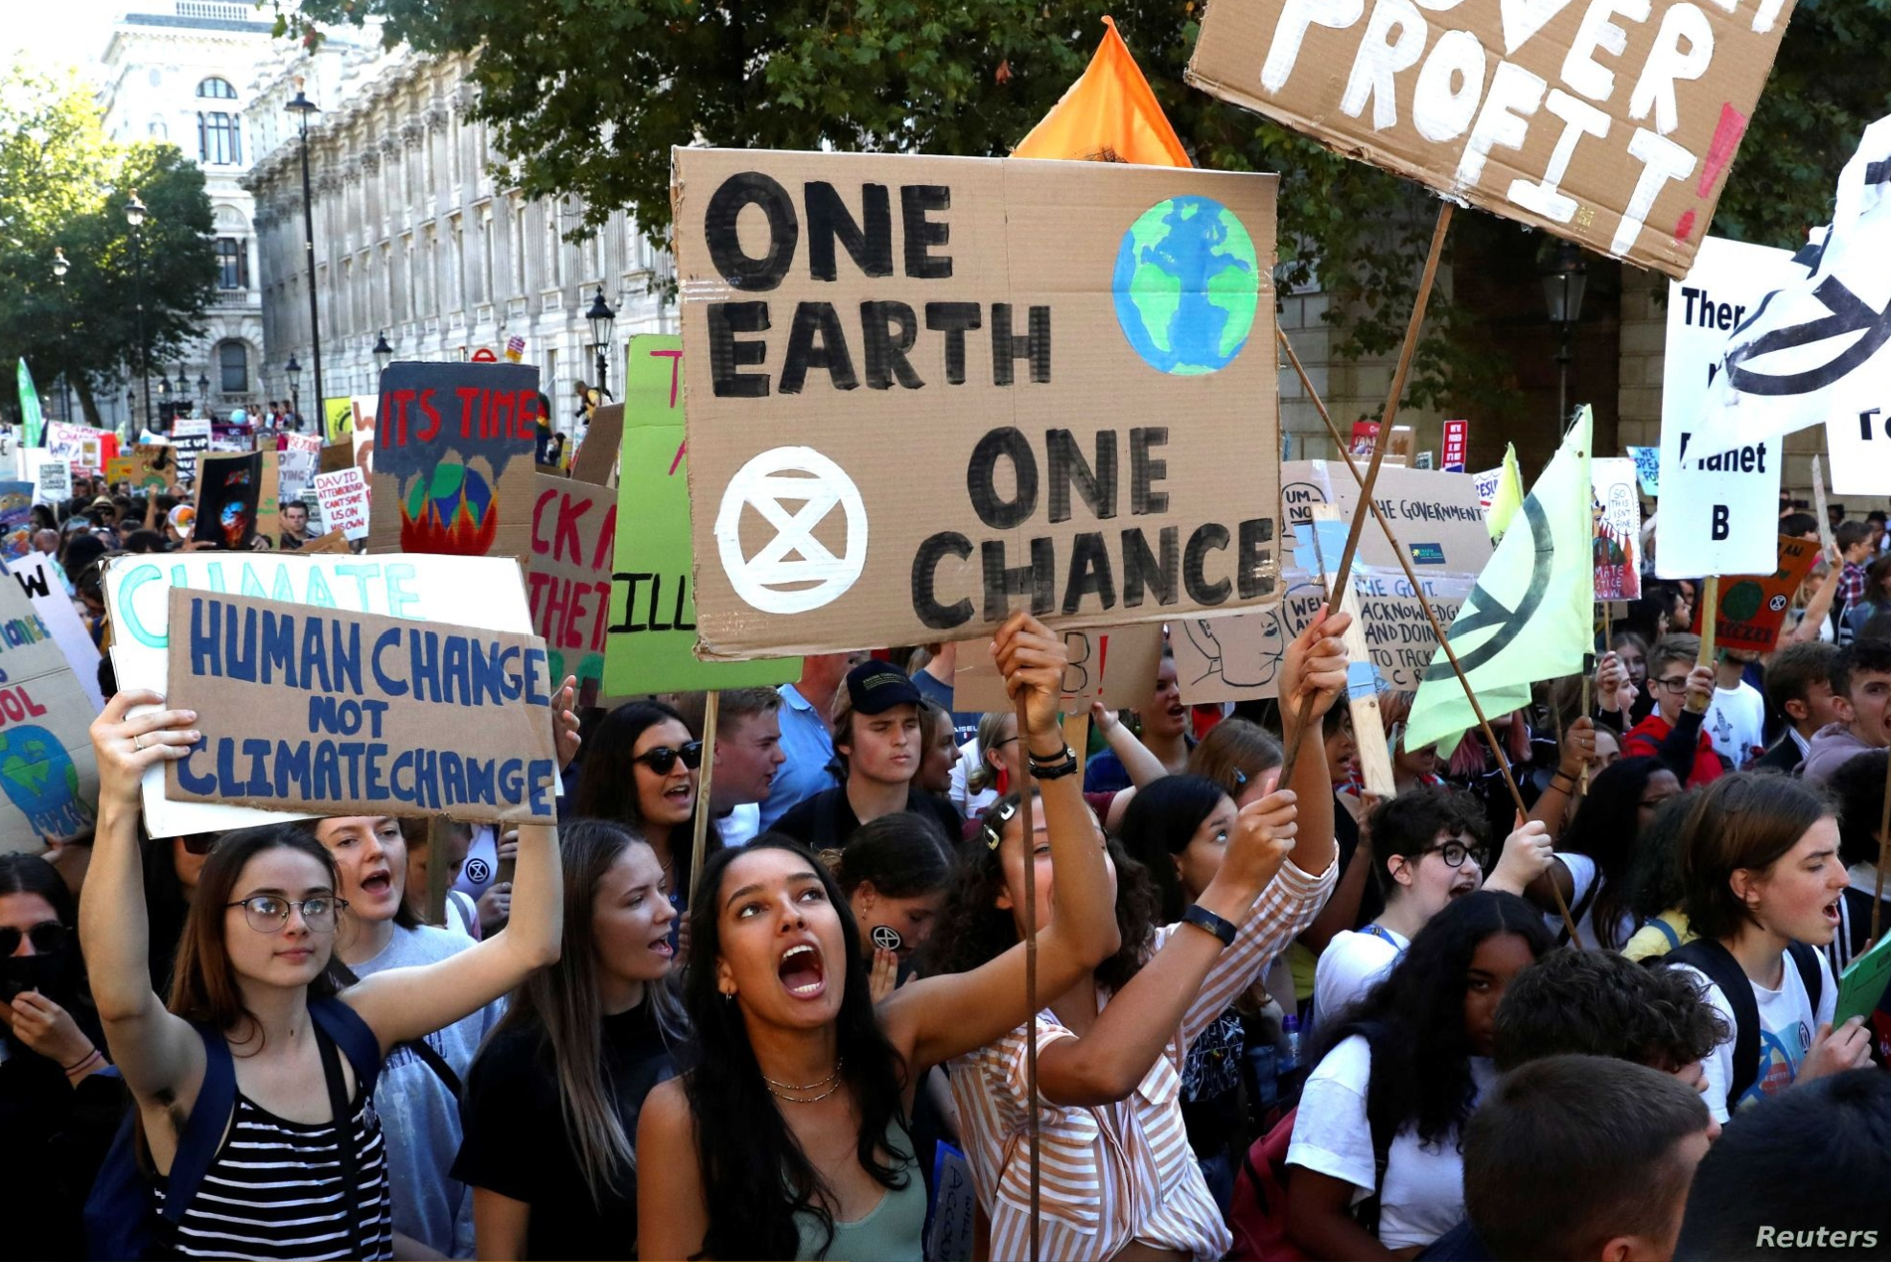
Conclusion
Helping educate people
Key Problems
Future Development

